Slide 1


RANG: India's Fast Fashion Contender
An everyday-first men’s casual wear brand built around mood-based styling and self-expression

Slide 2
PHASE 1

Slide 3
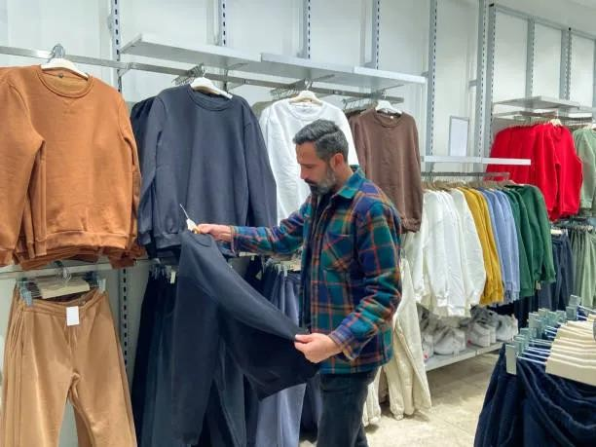
Introduction to brand and product
What RANG Stands For:
Digital-fiirst men’s casual wear brand blending comfiort with modern street style.
Designed fior everyday wear that refilects mood, personality and confiidence.
Target Customer Focus:
Urban Gen Z & young millennial men seeking afifiordable, trendy, versatile casual wear.
Digitally active youth who prefier lifiestyle-driven fiashion fior daily use.
What Makes RANG Unique:
Everyday-First Positioning: Built specifiically fior daily casual wear, not just smart-
casual or budget basics.
Youth-First Identity: Designs and communication fiocused on Gen Z lifiestyle, moods, and selfi-expression.
Mid-Afifiordable Premium Feel: Better quality and fiit than budget brands, at more accessible prices than premium labels.

Slide 4
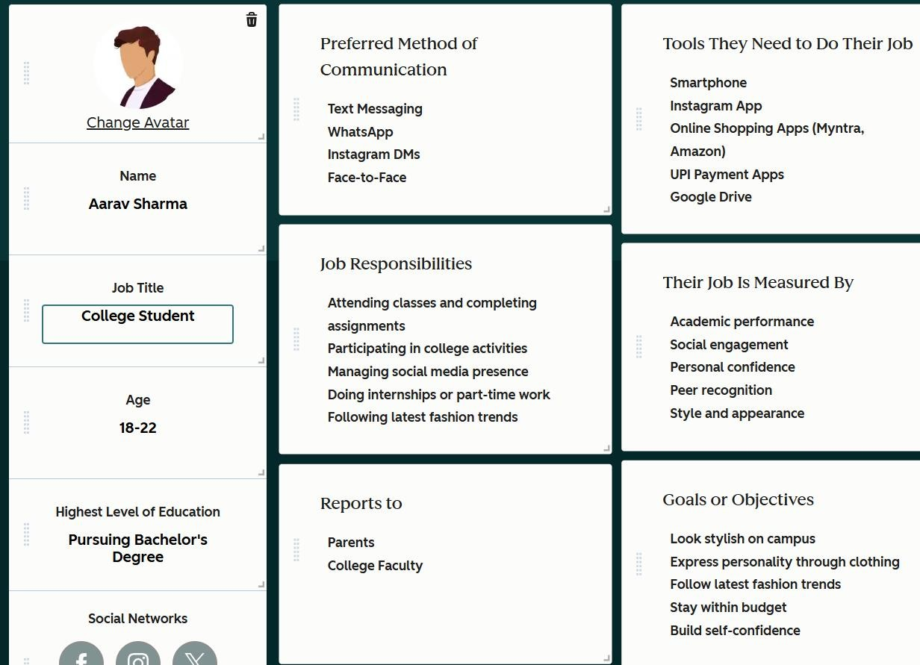
PERSONA 1

Slide 5
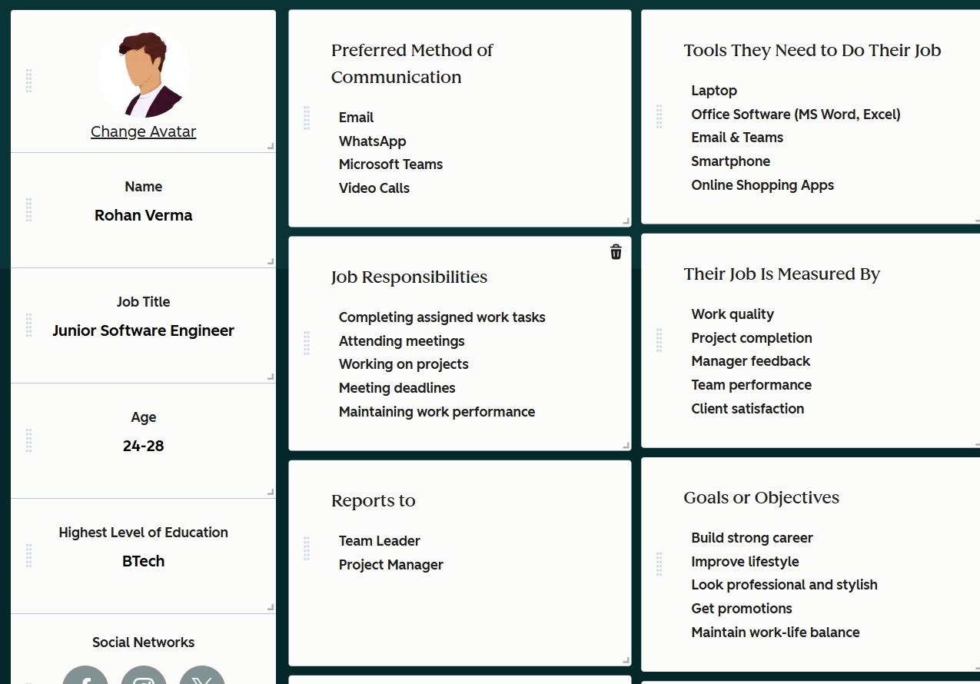
PERSONA 2

Slide 6
Competitive Positioning Analysis
Gap Area | Allen Solly (Mid-Premium) | Peter England (Mid-Range) | Roadster (Budget) | RANG – How You Use This Gap
Everyday-First Positioning | Leans smart-casual; not daily casual-fiirst | Mix ofi basics + semi-fiormal; not everyday-fiocused | Casual, but trend-fiirst not habit-fiirst | Own everyday casual wear fior daily college, work-casual & hangouts
Youth Identity & Emotional Connect | More polished, less Gen Z expressive | Functional, low lifiestyle storytelling | Youthfiul but price/trend-led | Build youth-fiirst, identity- driven brand voice
Style–Quality–Price Balance | Good quality, higher price | Decent quality, safie designs | Afifiordable but quality inconsistency | Ofifier better quality than budget at mid-afifiordable price
Curated Styling / Outfiit Solutions | Product-led displays | Basic staples; limited styling | Item-based selling | Provide ready looks, outfiit drops, styling guides
Community & Repeat- Wear Culture | Low community engagement | Low UGC/community | Some digital buzz, low loyalty | Build UGC, creator collabs, repeat-wear challenges

Slide 7
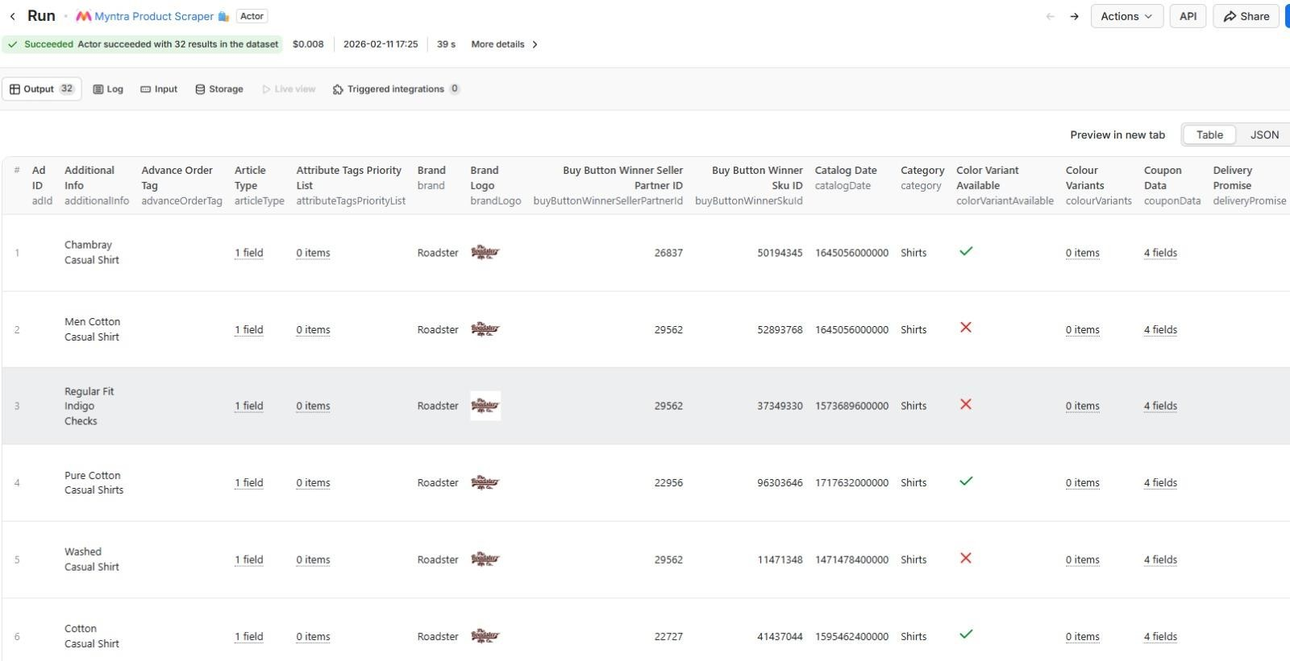
APIFY

Slide 8
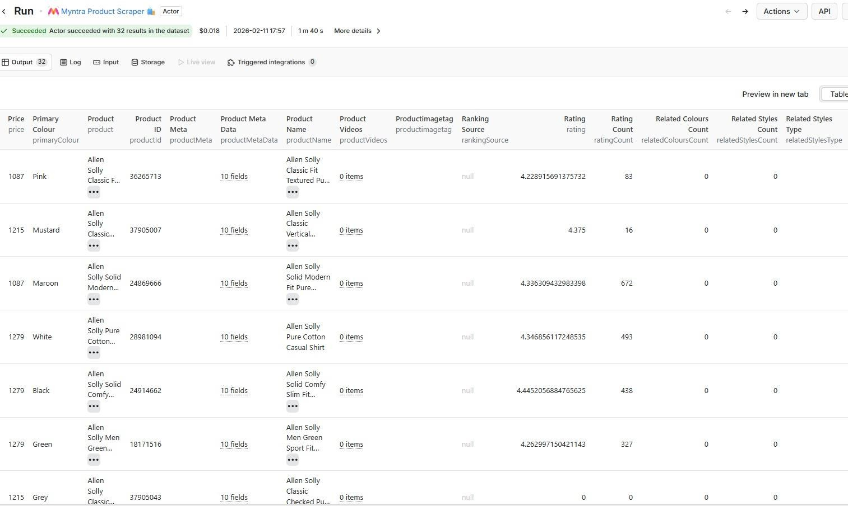
APIFY

Slide 9
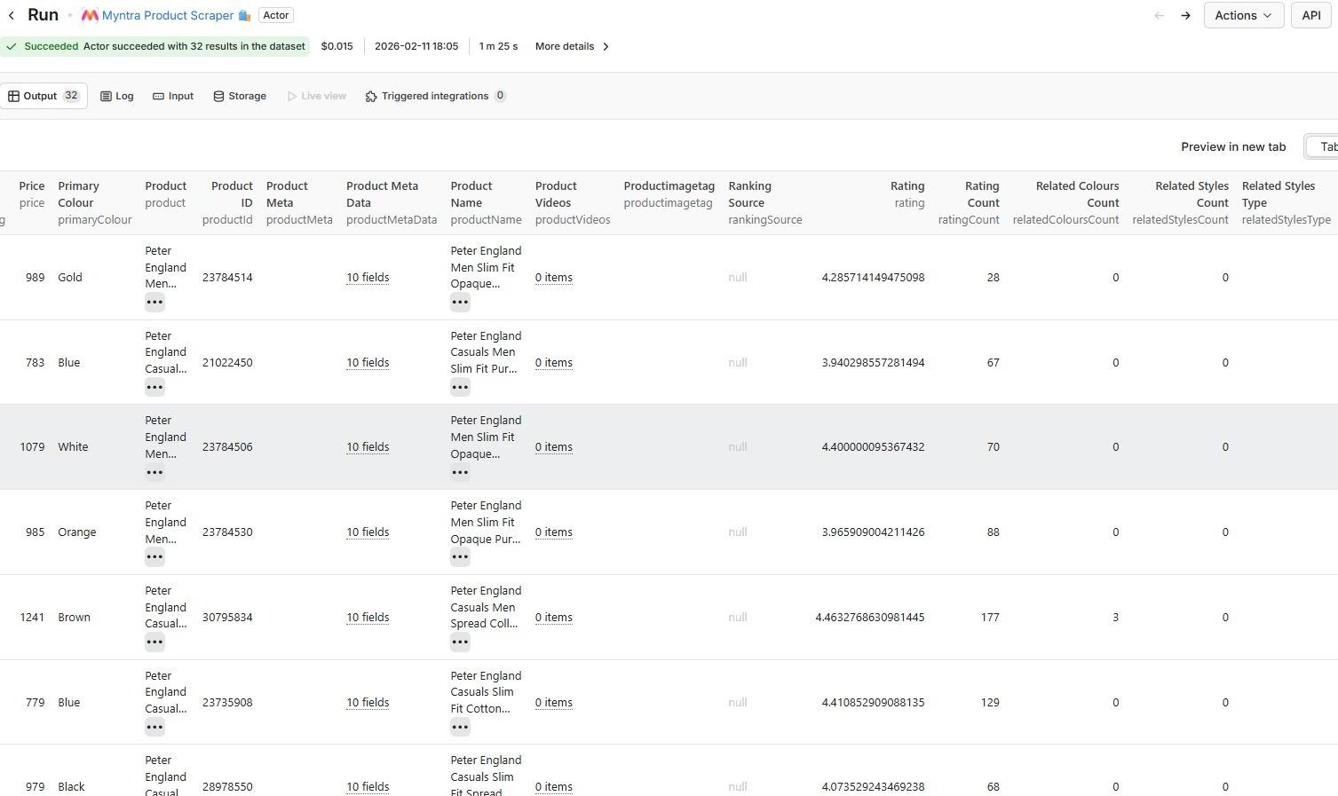
APIFY

Slide 10


Slide 11
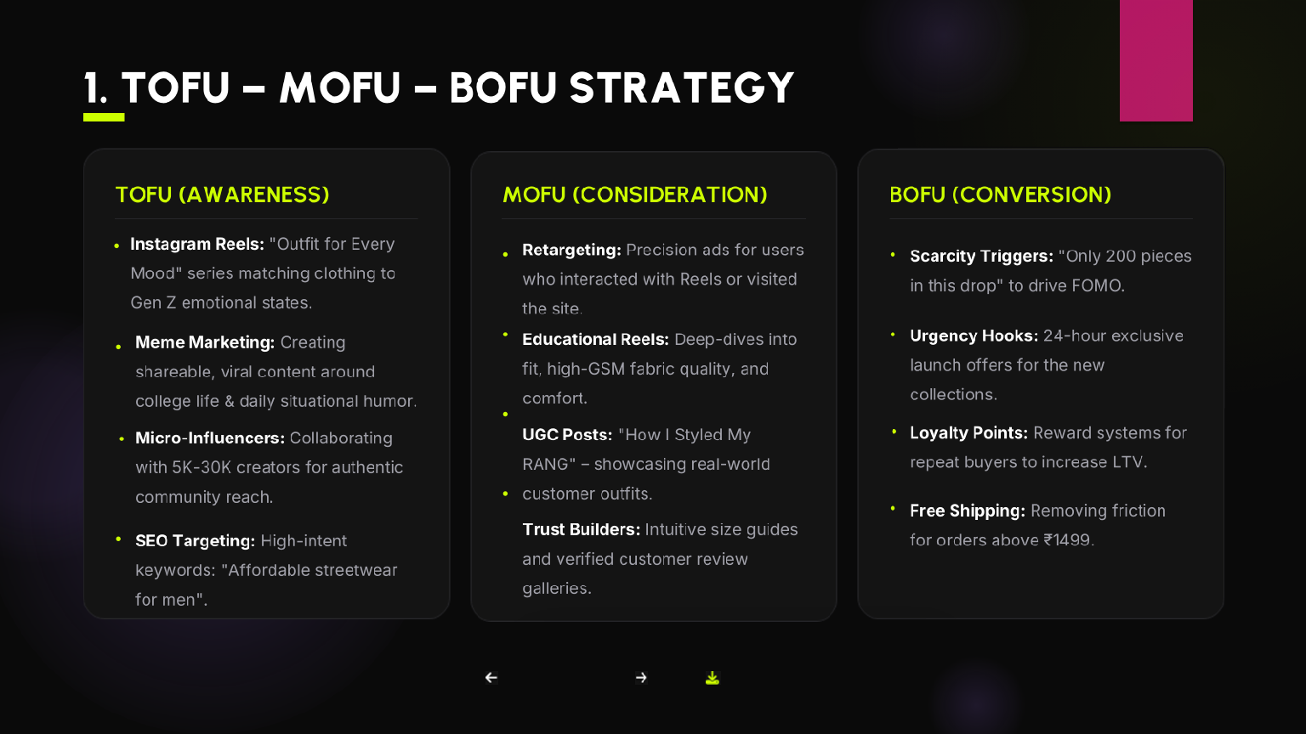

Slide 12
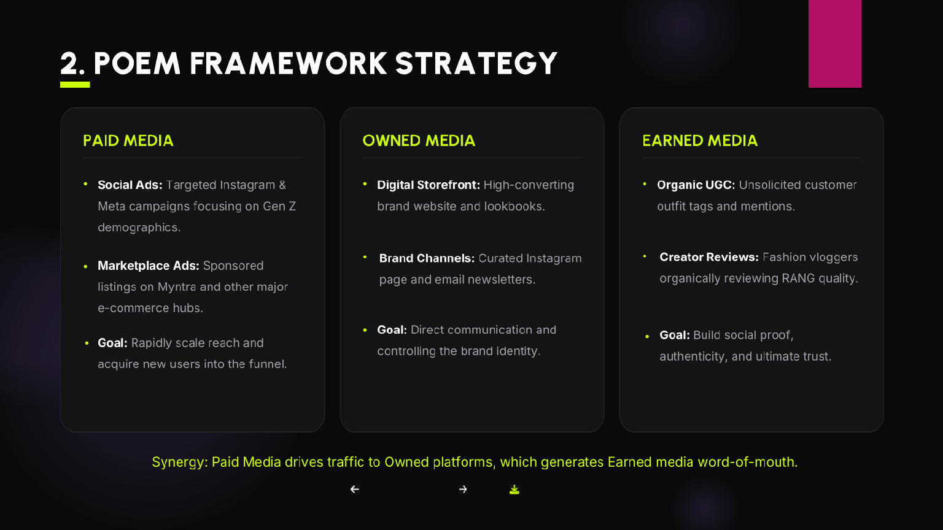

Slide 13
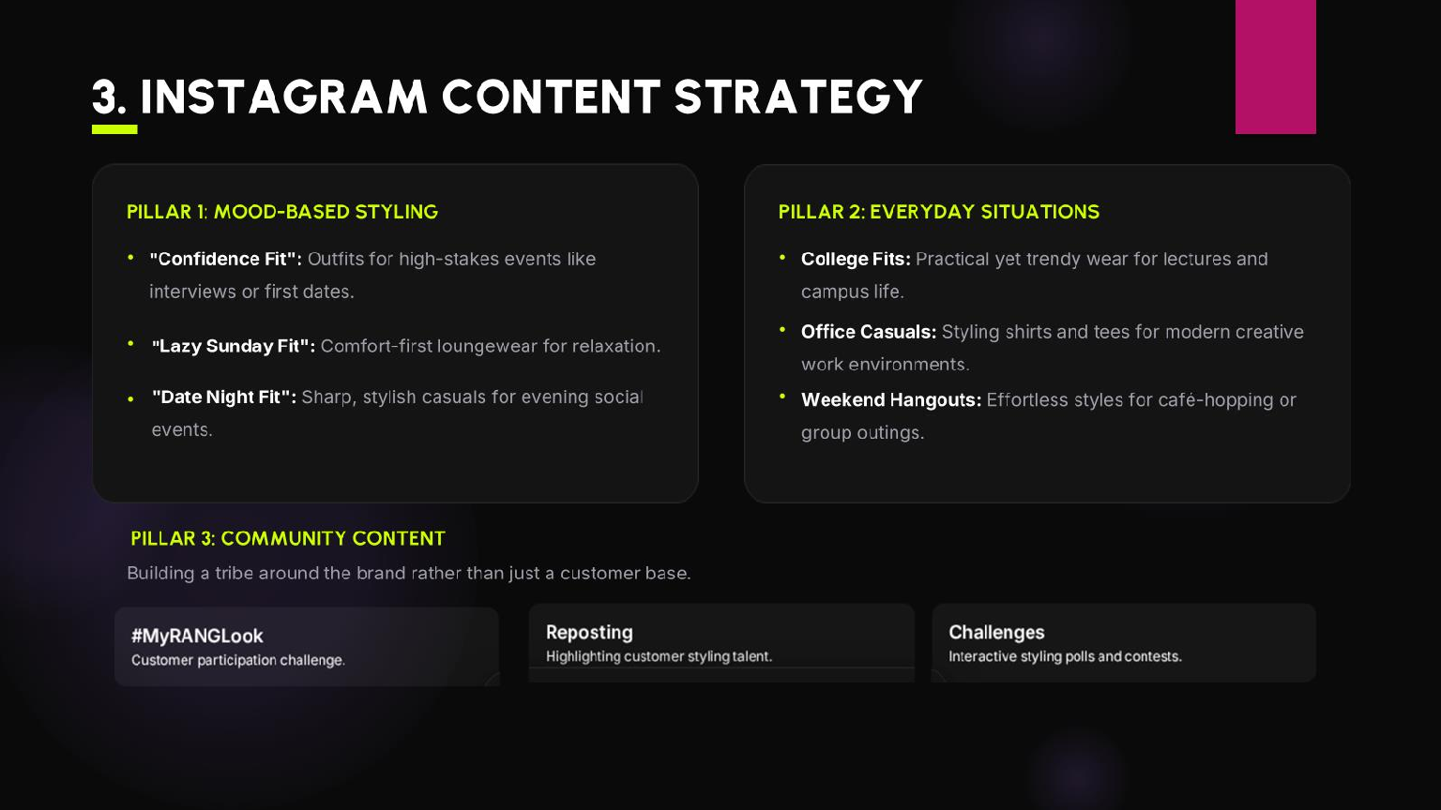

Slide 14
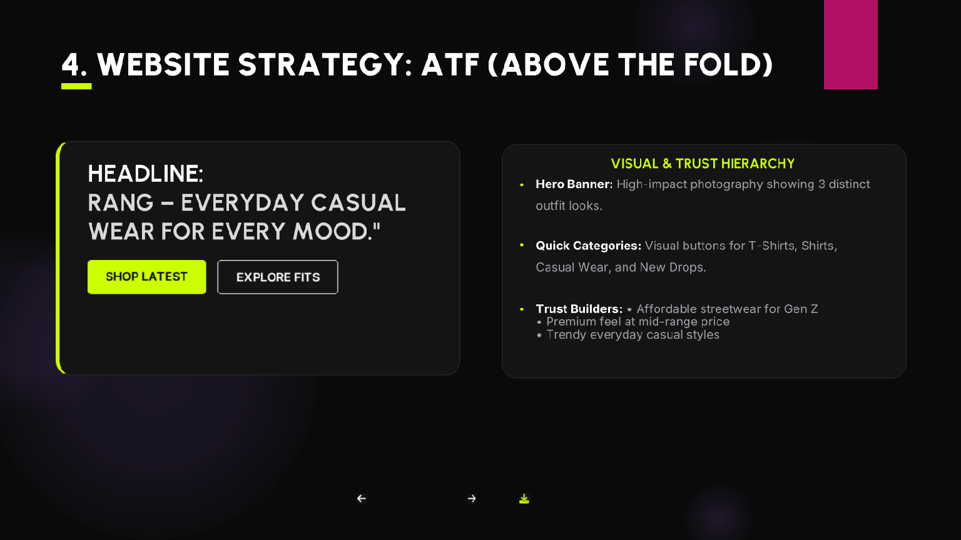

Slide 15
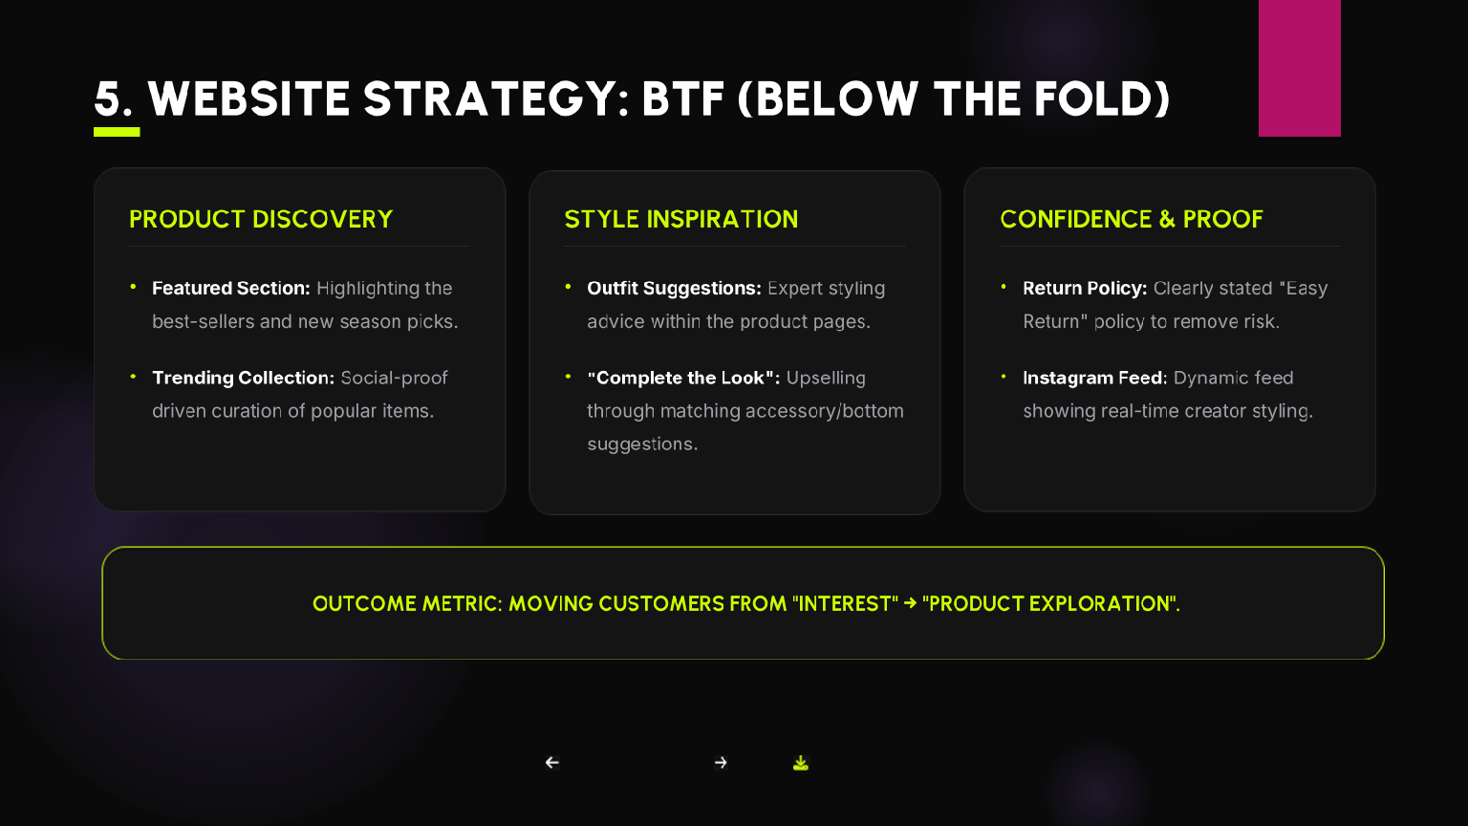

Slide 16
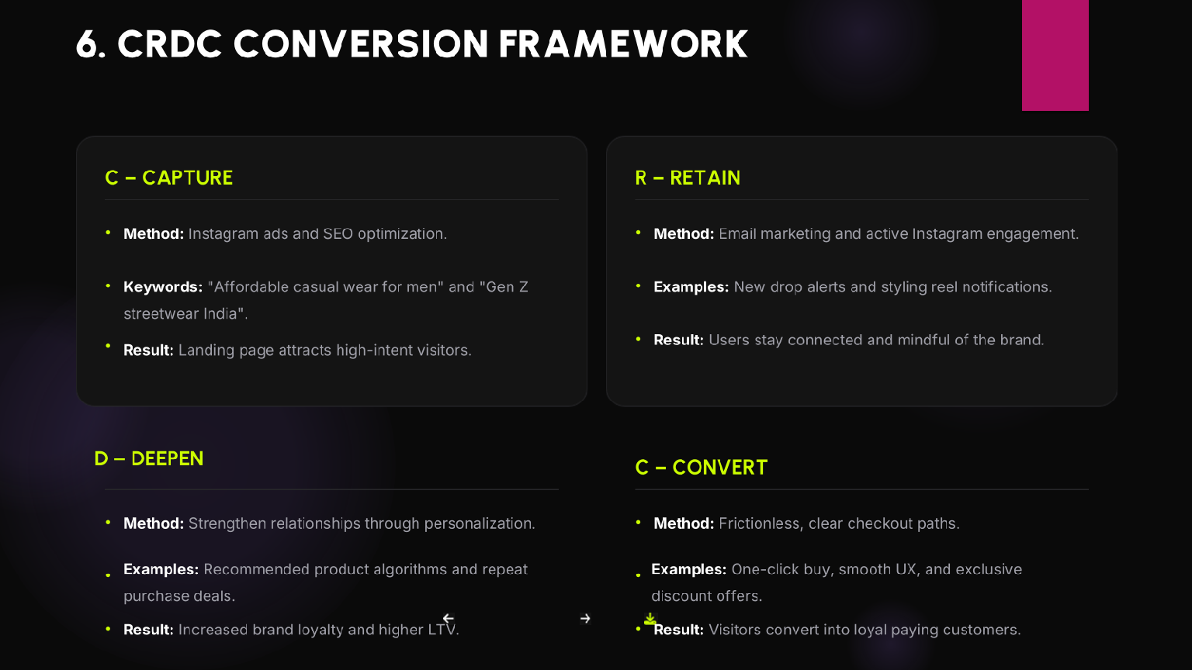

Slide 17
PHASE 3

Slide 18
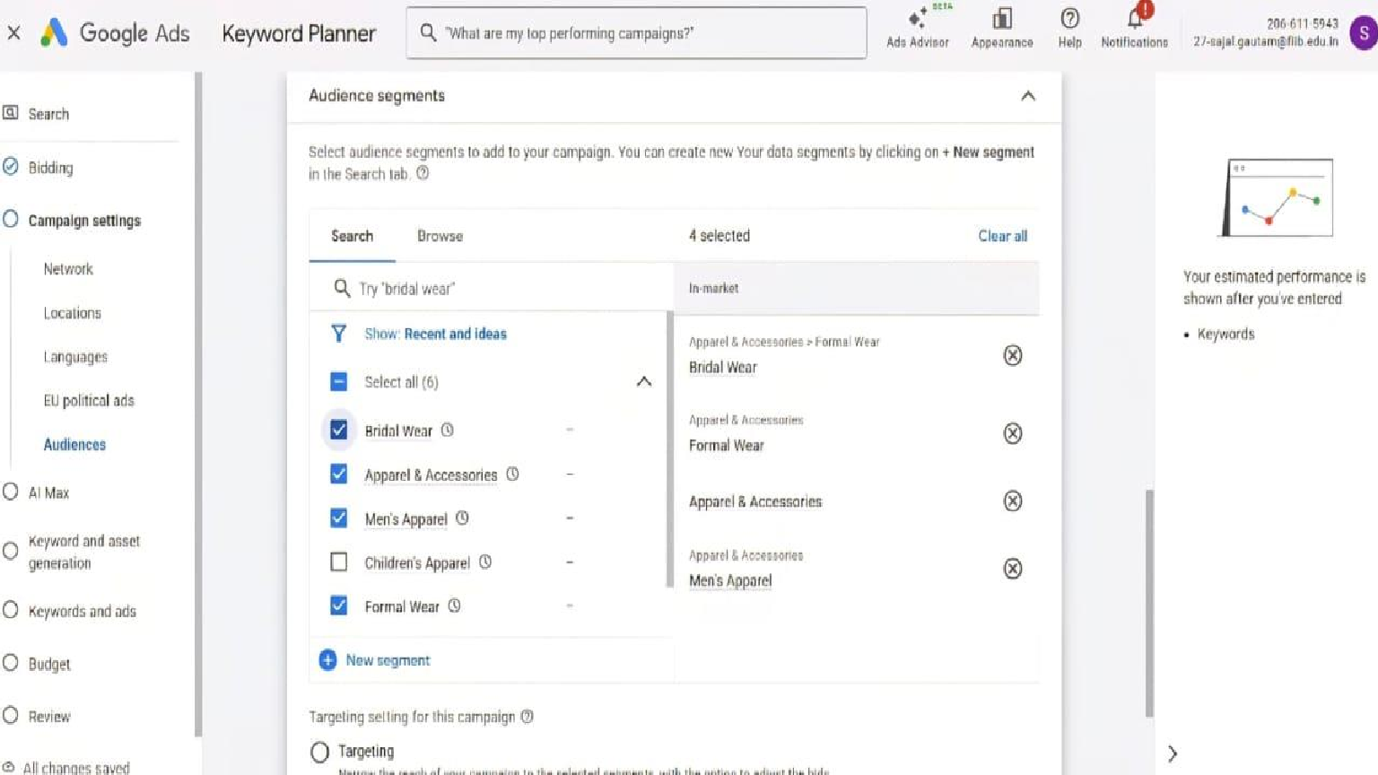

Slide 19
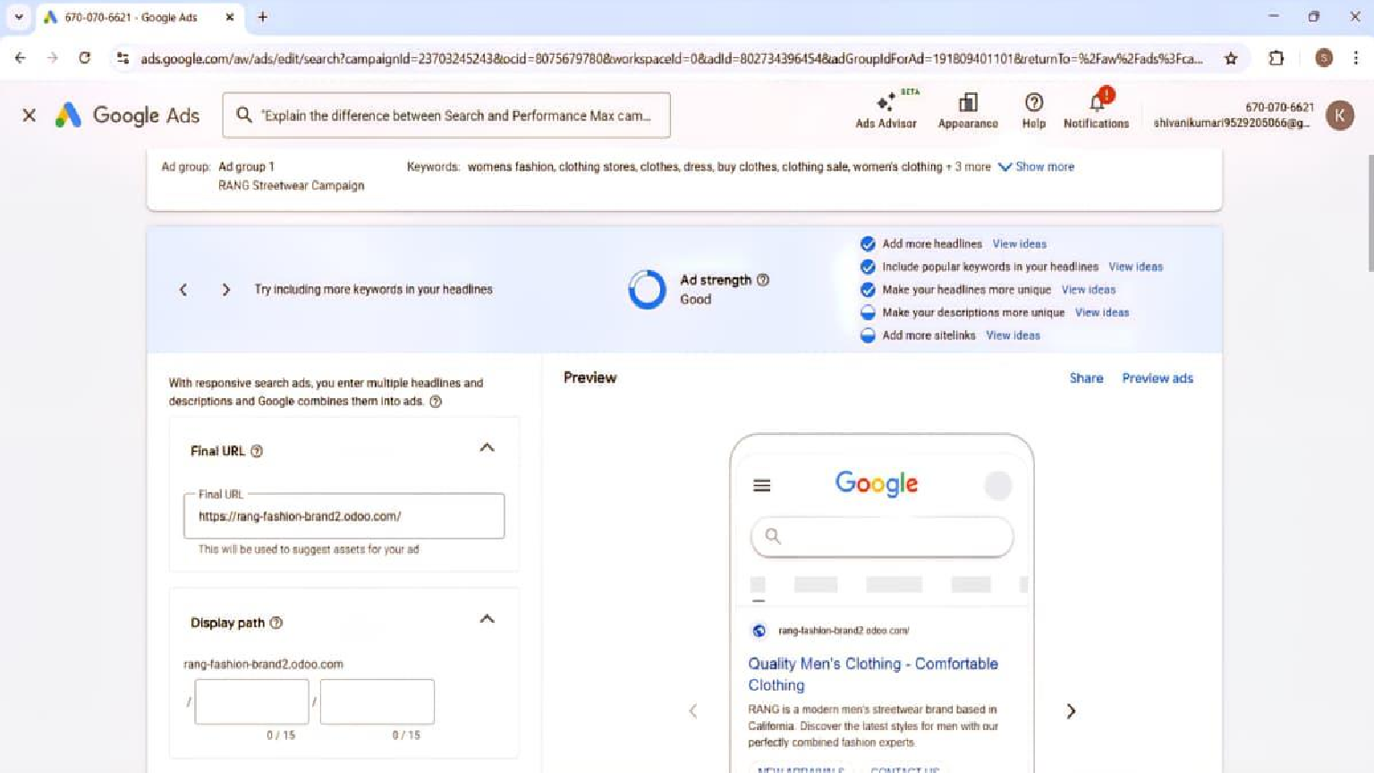

Slide 20
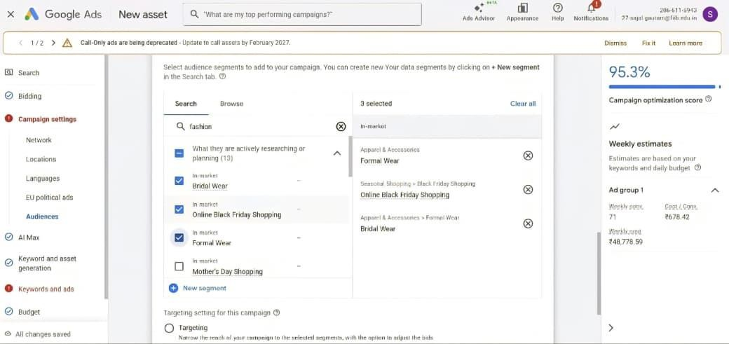
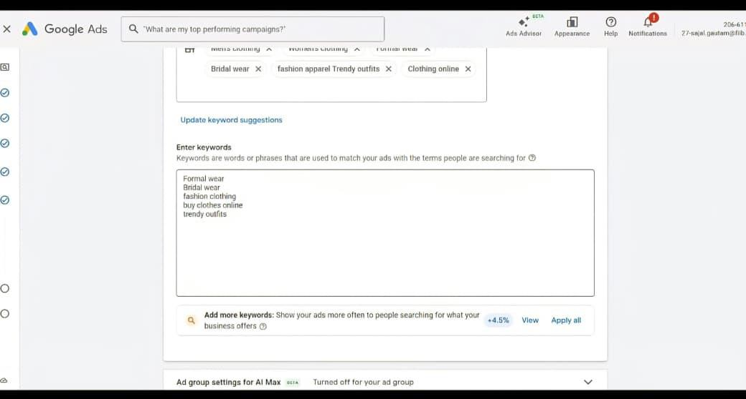

Slide 21
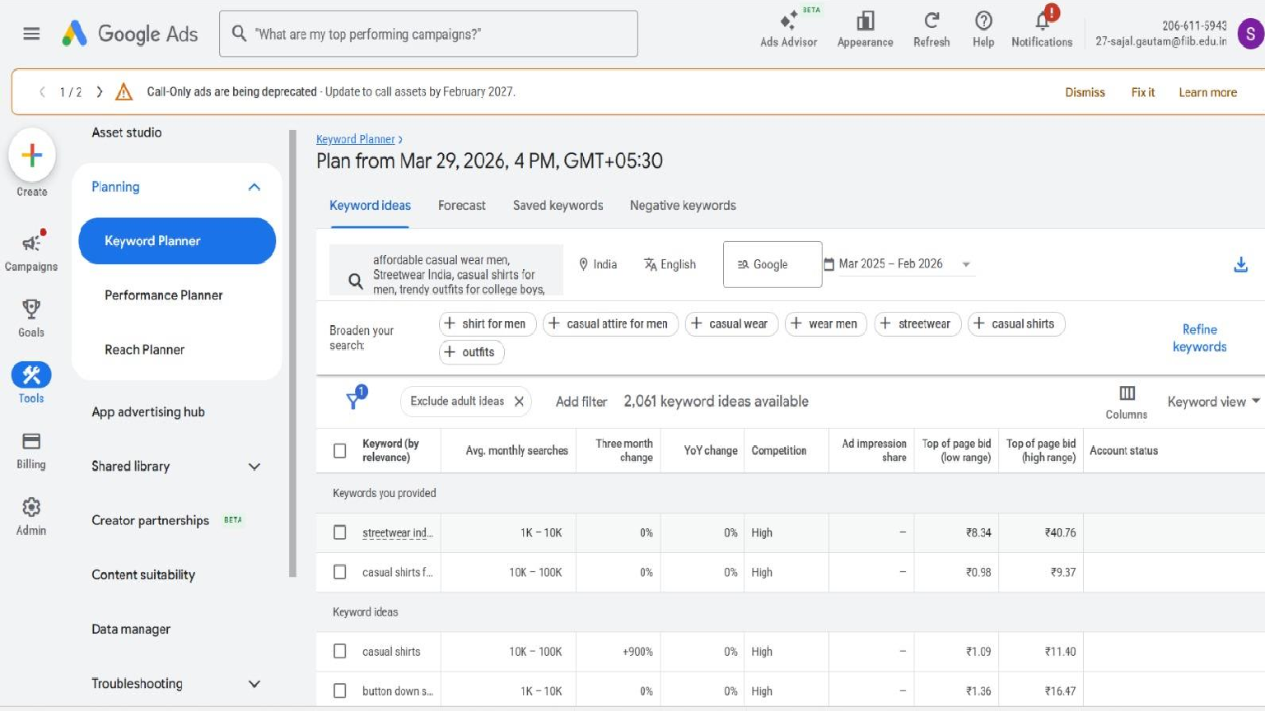

Slide 22
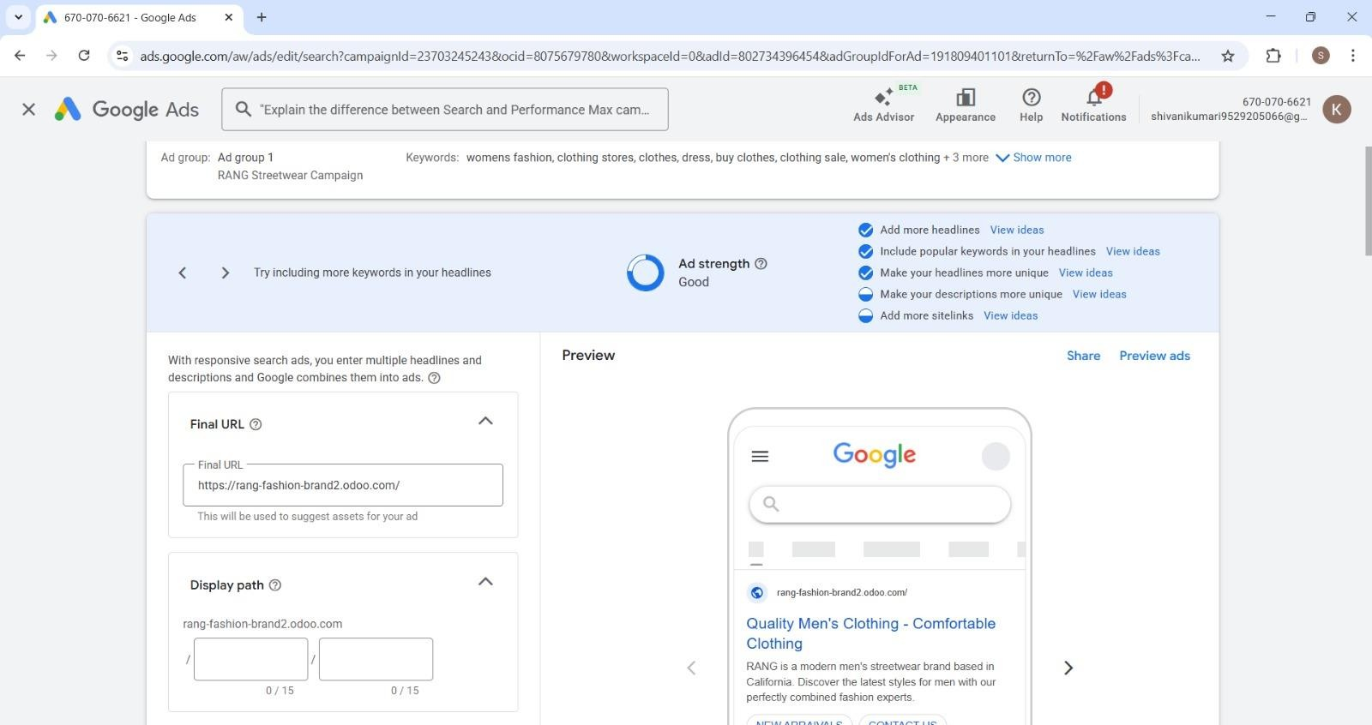
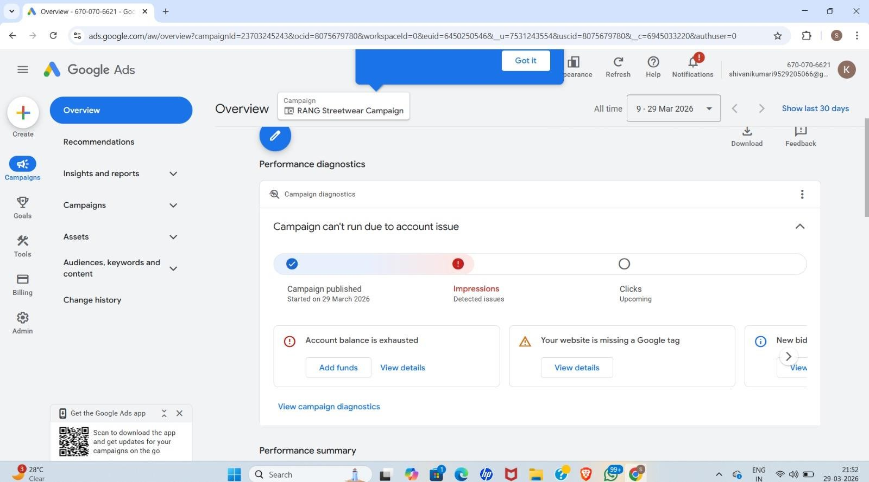

Slide 23

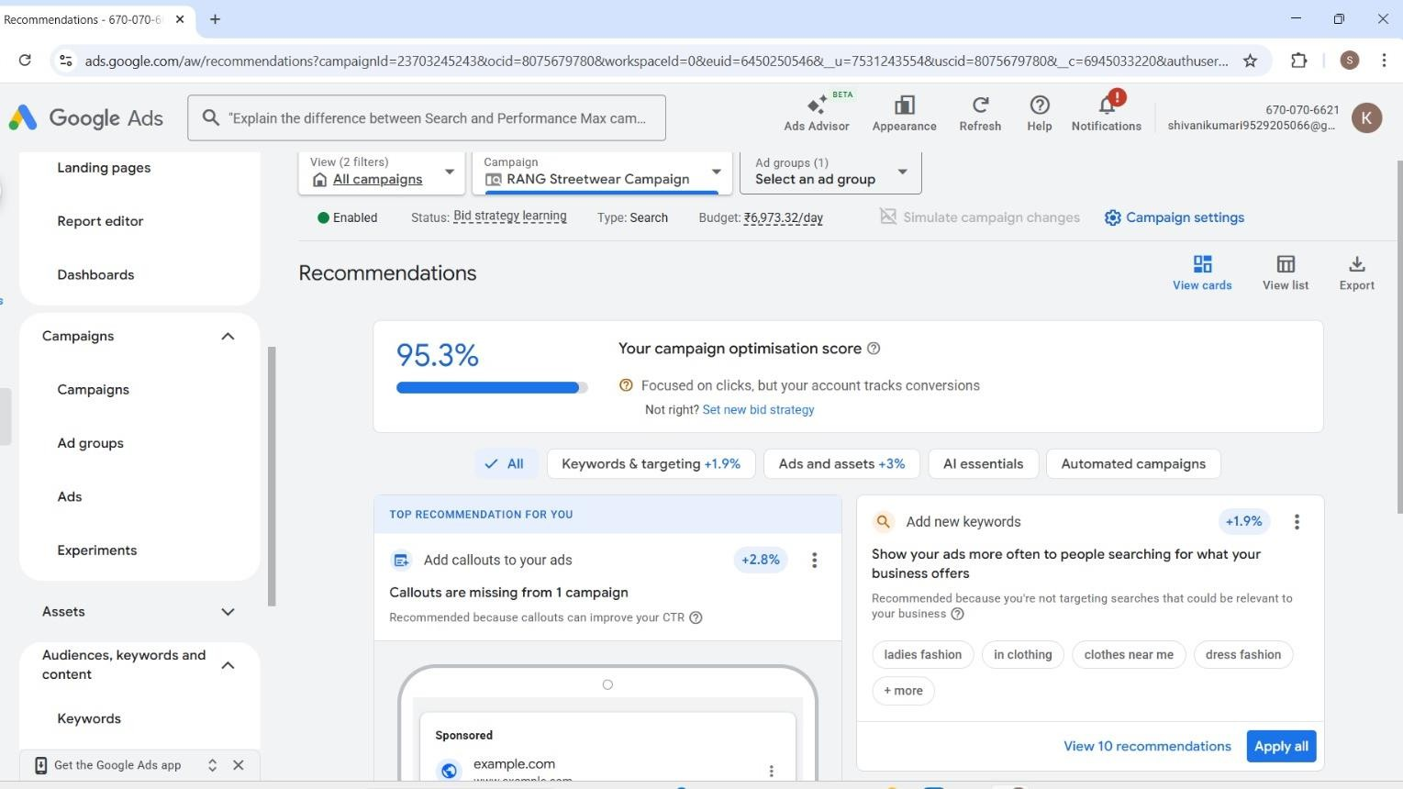
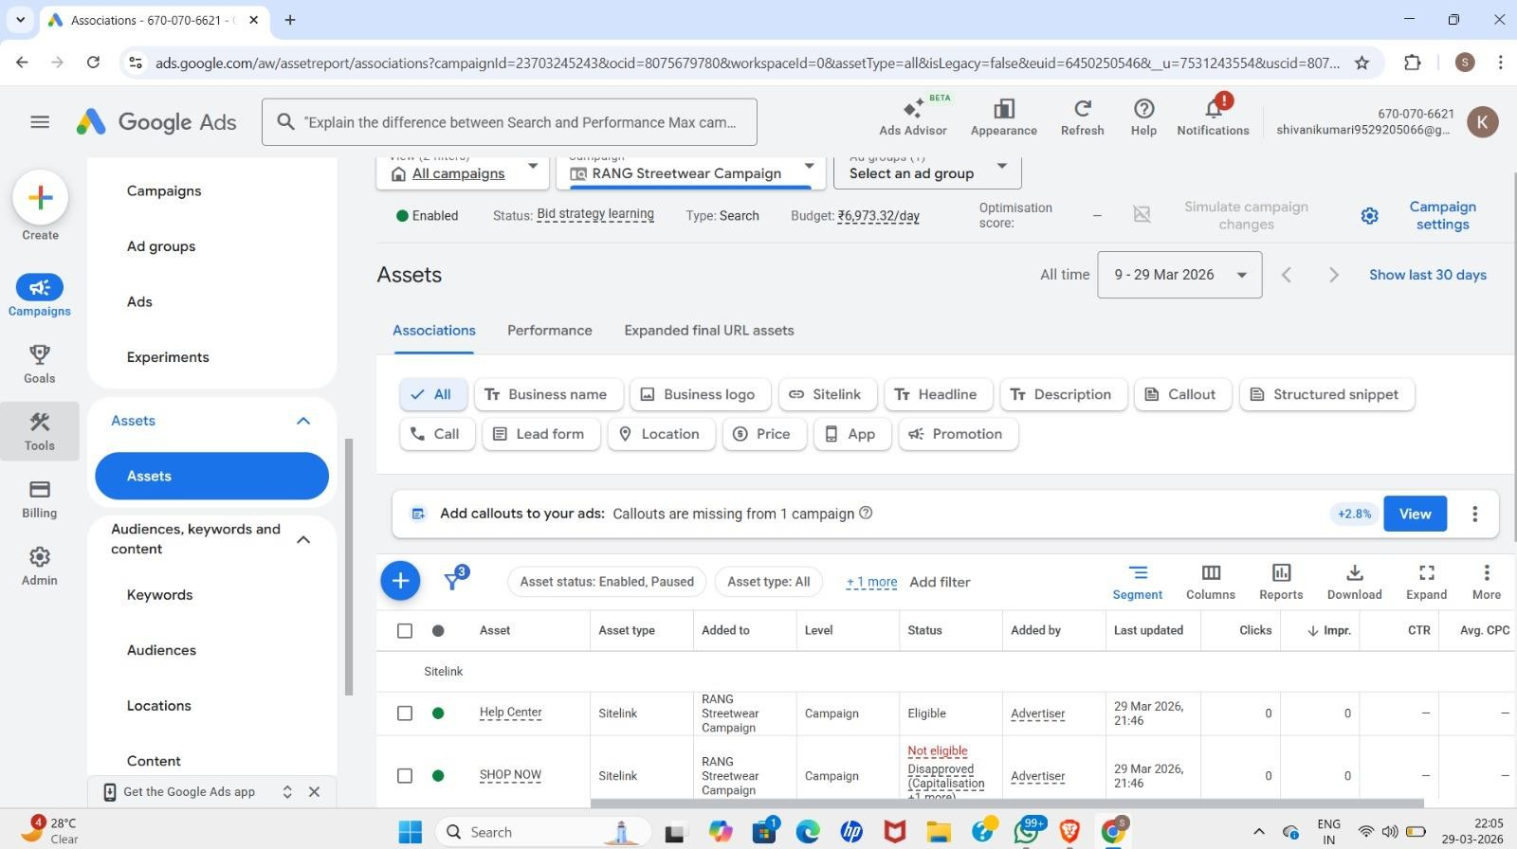

Slide 24
AD COPIES
Ad 1
Headline: Upgrade Your Style with RANG
Description: Shop trendy and comfortable men's casual wear at affordable prices.
Ad 2
Headline: Stylish Casual Wear for Men
Description: Discover latest shirts, t-shirts and everyday outfits for men.
Ad 3
Headline: Buy Men's Casual Wear Online
Description: Explore premium quality fashion designed for modern men.
Ad 4
Headline: Trendy Outfits for Men
Description: Stay stylish with RANG’s latest casual wear collection.
Ad 5
Headline: Affordable Men's Fashion
Description: Upgrade your wardrobe without spending too much.

Slide 25
Ad 6
Headline: Shop Casual Shirts & T-Shirts
Description: Comfortable and stylish clothing for daily wear.
Ad 7
Headline: New Collection by RANG
Description: Fresh styles just dropped. Shop now before it’s
gone!
Ad 8
Headline: Men's Streetwear Collection
Description: Discover trendy and modern streetwear for Gen Z
men.
Ad 9
Headline: Comfortable Casual Wear
Description: Perfect outfits for everyday comfort and style.
Ad 10
Headline: Shop Men's Fashion Now
Description: Explore RANG’s stylish and affordable clothing
collection.

Slide 26
AD EXTENSIONS
Sitelink Extensions
Shop Now – Explore latest fashion collection
New Arrivals – Check out newly launched styles
Best Sellers – Discover trending outfits
Contact Us – Get in touch for support
Callout Extensions
Free Delivery
Easy Returns
Premium Quality
Affordable Prices
Limited Time Offer
Trendy Styles
Structured Snippet Extensions Header: Categories
Shirts
T-Shirts
Streetwear
Casual Wear
Men's Fashion

Slide 27
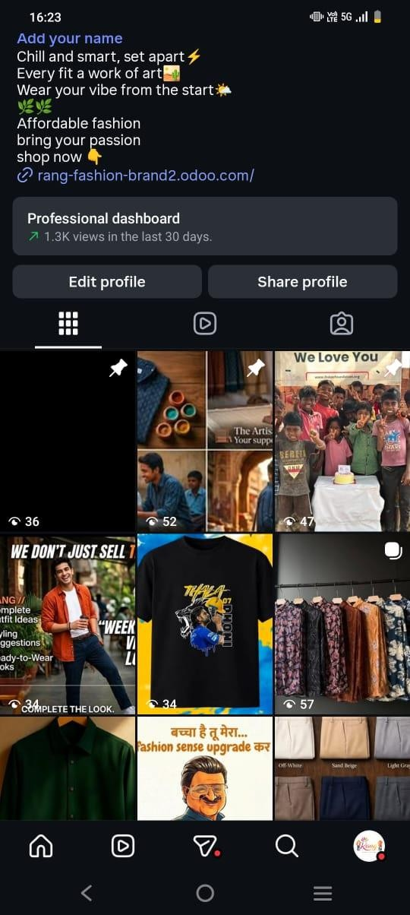
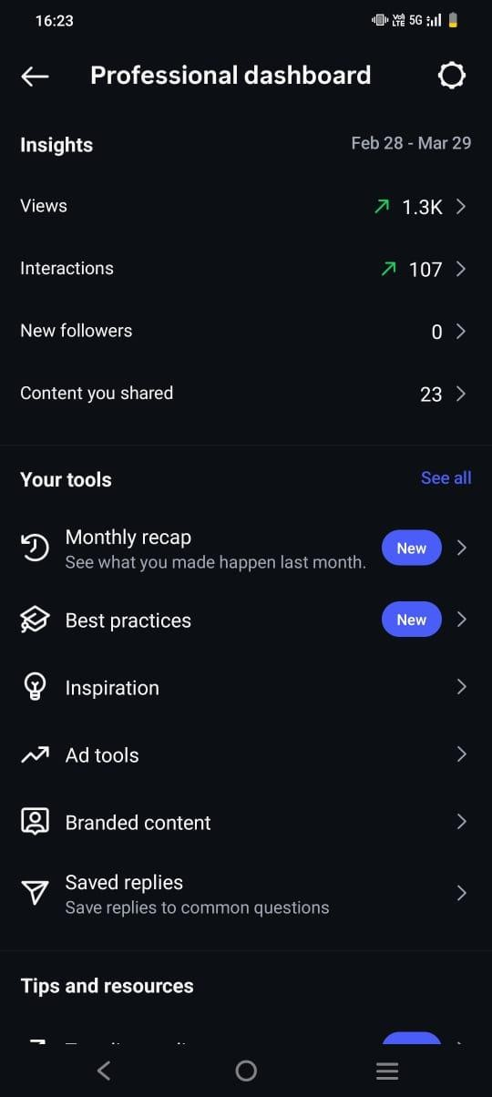

Slide 28
PHASE 4

Slide 29
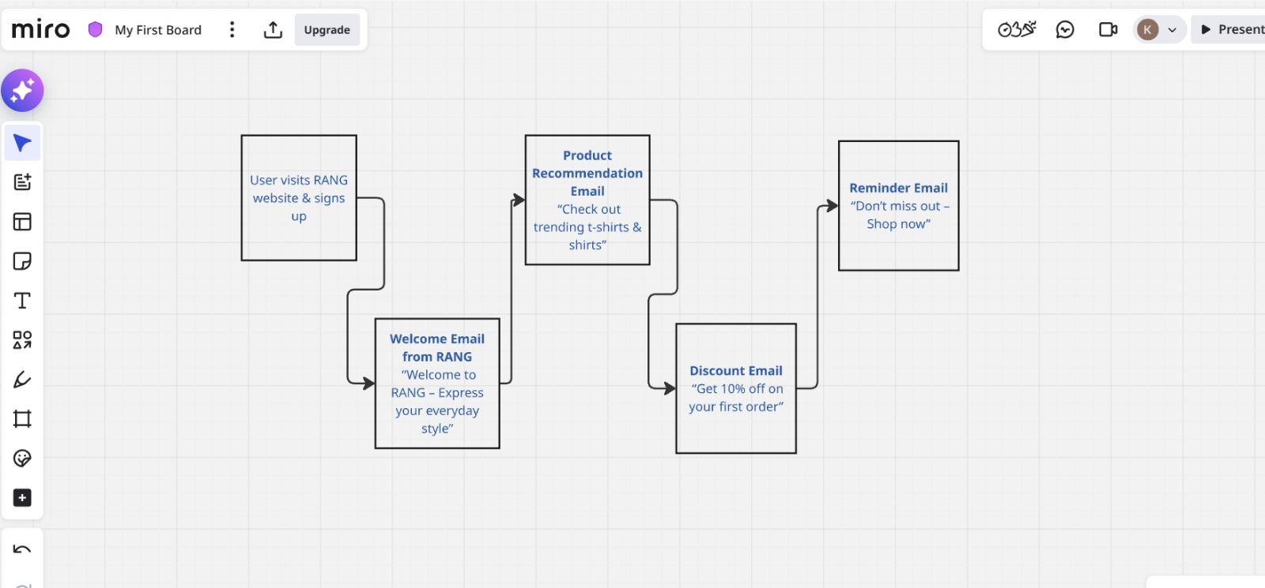
Email Workflow( MIRO)

Slide 30
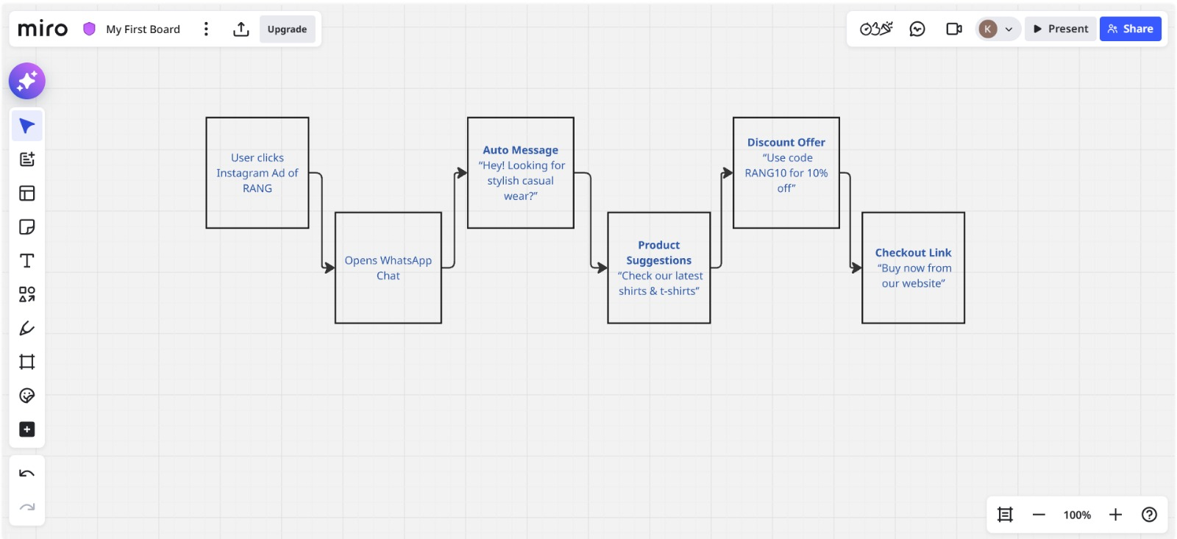
WhatsApp Workflow (Miro)

Slide 31
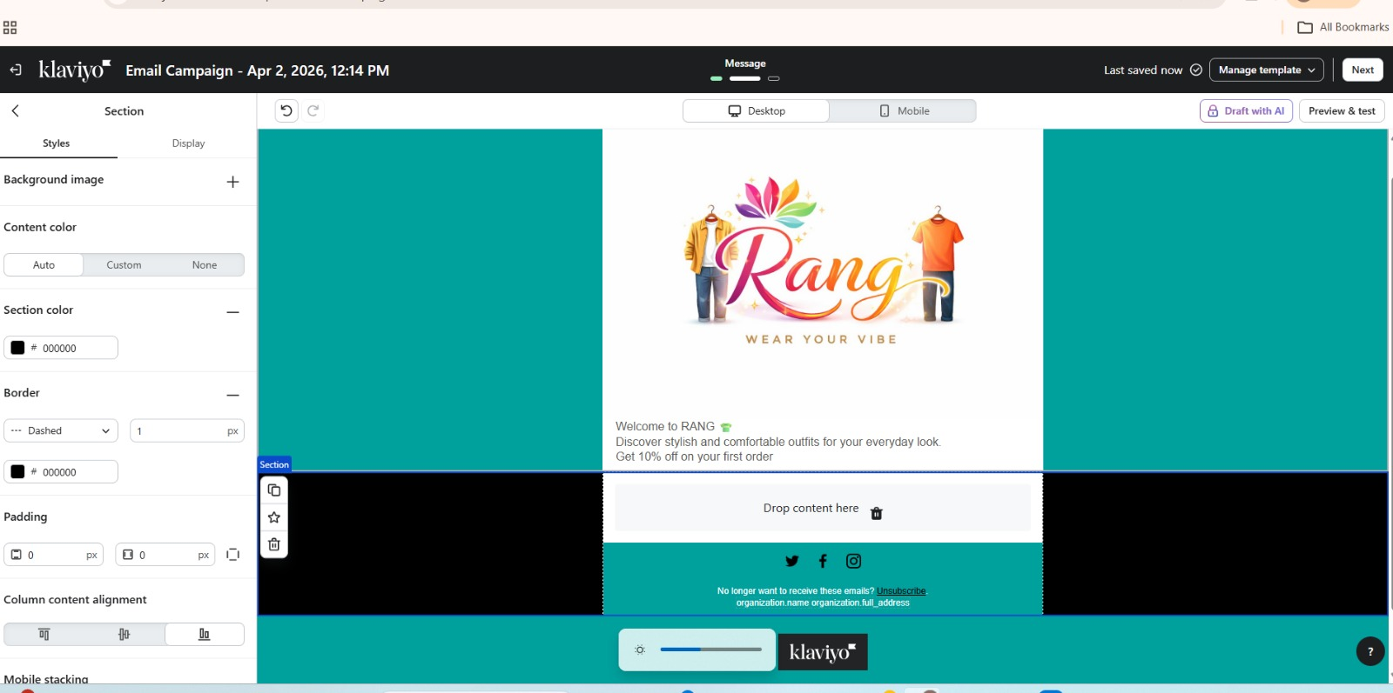
EMAIL CAMPAIGN DESIGN (KLAVIYO)

Slide 32
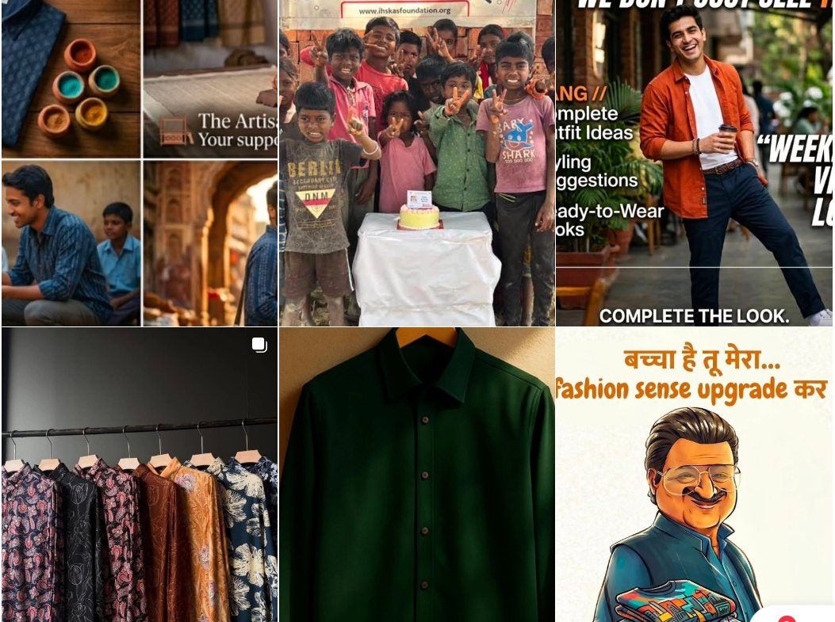
ORGANIC CONTENT STRATEGY
Platform: Instagram
Content Types:
Reels (outfit styling / daily looks)
Trend-based posts
Engagement posts
Goal:
Build followers
Increase engagement
Improve brand awareness

Slide 33
CAMPAIGN OBJECTIVES
Increase website traffic by 15–20% in one month
Generate 100–200 leads from email/WhatsApp campaigns
Achieve 2–3% conversion rate (people who buy after visiting)
Grow Instagram engagement by 20–25% (likes, comments, shares)
Increase newsletter sign-ups by 10–15%

Slide 34
https://www.instagram.com/rang_fashio nbrand?igsh=c2owYnZzaHdpZ2Q4
https://rang-mens-wear.odoo.com/

